Slide 1
Mini MVC LD0230 웹정보시스템 프로젝트
성신여자대학교
정보시스템공학과
홍 기 형

Slide 2
Objectives
Build a simple web app based on MVC model

Slide 3
Build a web application
4 steps
Review the user’s view and high-level architecture
Create the development environment (IDE like eclipse)
Create the deployment environment
Perform iterative development and testing
Design → Coding → Testing → (re)Design → Coding → …

Slide 4
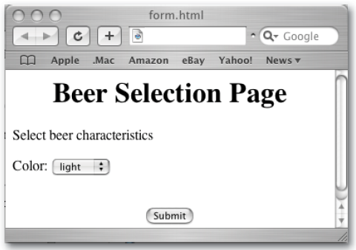
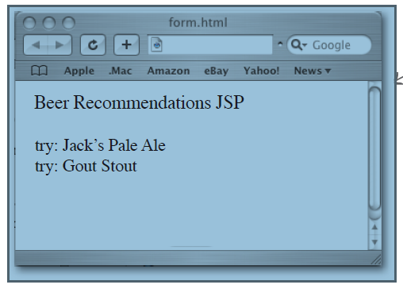
Beer Advisor User’s View
starting to browse ‘form.html’
select the color value
then submit it to the servlet
the server returns the result (recommendation of beer)

Slide 5
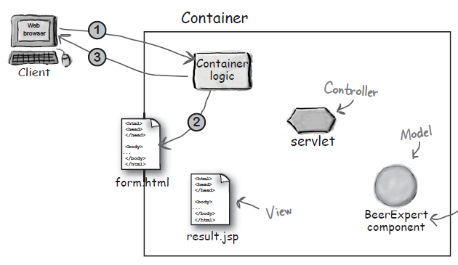
Handling sequence
The client makes a request for the form.html page.
The Container retrieves the form.html page.
The Container returns the page to the browser, where the user answers the questions on the form and...

Slide 6
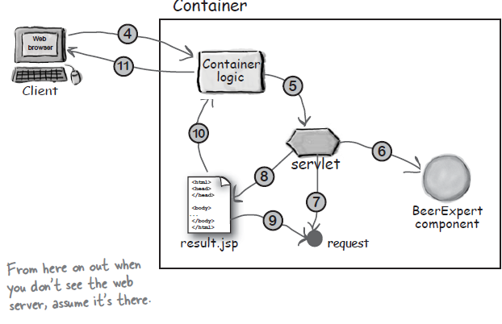
Handling sequence
The brow send the request data to the container.
The Container findd the correct servlet based on the URL, and passes the request to the servlet.
The servle calls the BeerExpert for help
The expert class returns an answer , which the servlet adds to the request object.
The servlet forwards the request to the JSP.
The JSP gets the answer from the request object.
Thee JSP generates a page for the Container.
The container returns the page to the user.

Slide 7
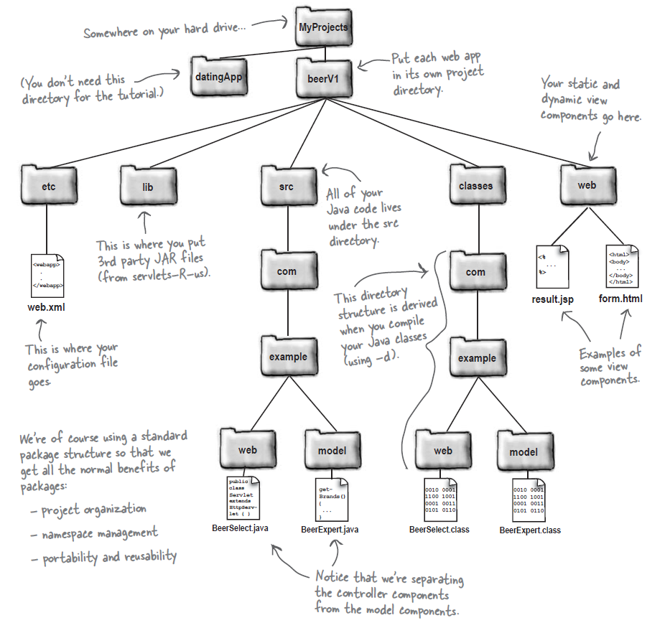
Development Environment
** Eclipse

Slide 8
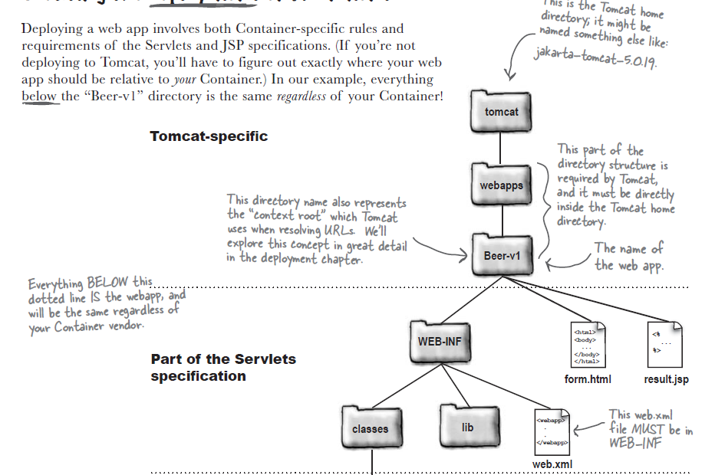
Deployment Environment

Slide 9
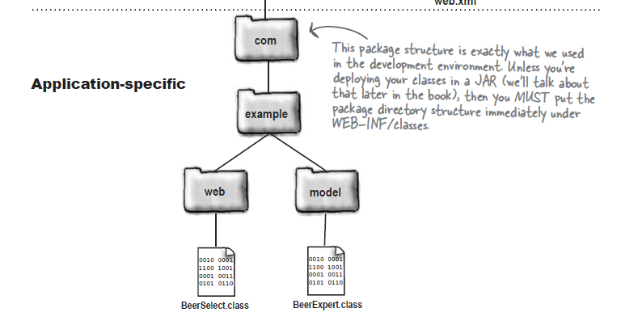
Deployment Environment

Slide 10
Steps for building the app
Build and test the HTML form that the user will first request.
Build and test version 1 of the controller servlet with the HTML form. This version is invoked via the HTML form and prints the parameter it receives.
Build a test class for the expert / model class, then build and test the expert / model class itself.
Upgrade the servlet to version 2. This version adds the capability of calling the model class to get beer advice.
Build the JSP, upgrade the servlet to version 3 (which adds the capability of dispatching to the JSP), and test the whole app.

Slide 11
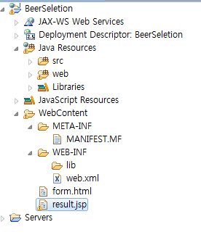
Build and test the HTML form that the user will first request.
<html><body>
<h1 align=”center”>Beer Selection Page</h1>
<form method=”POST” action=”SelectBeer.do”>
Select beer characteristics<p>
Color:
<select name=”color” size=”1”>
<option value=”light”> light </option>
<option value=”amber”> amber </option>
<option value=”brown”> brown </option>
<option value=”dark”> dark </option>
</select>
<br><br>
<center>
<input type=”SUBMIT”>
</center>
</form></body></html>
POST Method
URL pattern of the servlet
pull-down menu
Eclipse
create a new dynamic web project with web module version 2.4
form.html

Slide 12
Deploying the 1st Version
Create the HTML in your development environment
(form.html in WebContent at Eclipse)
Copy the file into the deployment environment
Create the DD in your development environment (automatically generate in Eclipse)
<web-app xmlns=”http://java.sun.com/xml/ns/j2ee”
xmlns:xsi=”http://www.w3.org/2001/XMLSchema-instance”
xsi:schemaLocation=”http://java.sun.com/xml/ns/j2ee/web-app_2_4.xsd”
version=”2.4”>
<servlet>
<servlet-name>Ch3 Beer</servlet-name>
<servlet-class>com.example.web.BeerSelect</servlet-class>
</servlet>
<servlet-mapping>
<servlet-name>Ch3 Beer</servlet-name>
<url-pattern>/SelectBeer.do</url-pattern>
</servlet-mapping>
</web-app>
actual servlet class path
create the servlet

Slide 13
Copy the DD file into the deployment environment (under WEB-INF/)
Start Tomcat
Test
‘form.html’ run on the server at Eclipse
** don’t forget to restart Tomcat after deploying some new applications

Slide 14
1st version servlet
package com.example.web;
import javax.servlet.*;
import javax.servlet.http.*;
import java.io.*;
public class BeerSelect extends HttpServlet {
public void doPost(HttpServletRequest request,
HttpServletResponse response)
throws IOException, ServletException {
response.setContentType(“text/html”);
PrintWriter out = response.getWriter();
out.println(“Beer Selection Advice<br>”);
String c = request.getParameter(“color”);
out.println(“<br>Got beer color “ + c);
}
}
BeerSelect.class

Slide 15
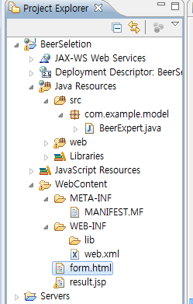
2nd Version
Separate Model from the servlet
Model : plain Java class “BeerExpert.java”
package com.example.model;
import java.util.*;
public class BeerExpert {
public List getBrands(String color) {
List brands = new ArrayList();
if (color.equals(“amber”)) {
brands.add(“Jack Amber”);
brands.add(“Red Moose”);
}
else {
brands.add(“Jail Pale Ale”);
brands.add(“Gout Stout”);
}
return(brands);
}
}

Slide 16
2nd Version Servlet (BeerSelect.class)
package com.example.web;
import com.example.model.*;
import javax.servlet.*;
import javax.servlet.http.*;
import java.io.*;
import java.util.*;
public class BeerSelect extends HttpServlet {
public void doPost(HttpServletRequest request,
HttpServletResponse response)
throws IOException, ServletException {
String c = request.getParameter(“color”);
BeerExpert be = new BeerExpert();
List result = be.getBrands(c);
response.setContentType(“text/html”);
PrintWriter out = response.getWriter();
out.println(“Beer Selection Advice<br>”);
Iterator it = result.iterator();
while(it.hasNext()) {
out.print(“<br>try: “ + it.next());
}
}
}

Slide 17
3rd Version
MVC Model
Model : BeerExpert.class (plain Java)
same as the 2nd version
View : result.jsp (JSP)
create under WebContent
Controller : BeerSelect.class (servlet)

Slide 18
Controller for 3rd version
package com.example.web;
import com.example.model.*;
import javax.servlet.*;
import javax.servlet.http.*;
import java.io.*;
import java.util.*;
public class BeerSelect extends HttpServlet {
public void doPost(HttpServletRequest request,
HttpServletResponse response)
throws IOException, ServletException {
String c = request.getParameter(“color”);
BeerExpert be = new BeerExpert();
List result = be.getBrands(c);
request.setAttribute(“styles”, result);
RequestDispatcher view = request.getRequestDispatcher(“result.jsp”);
view.forward(request, response);
}
}

Slide 19
View for 3rd verion (result.jsp)
<%@ page import=”java.util.*” %>
<html>
<body>
<h1 align=”center”>Beer Recommendations JSP</h1>
<p>
<%
List styles = (List)request.getAttribute(“styles”);
Iterator it = styles.iterator();
while(it.hasNext()) {
out.print(“<br>try: “ + it.next());
}
%>
</body>
</html>

